Slide 1





How do resource abundance and stochasticity affect animal movement?
Stefano Mezzini – M.Sc. Biol.

Slide 2
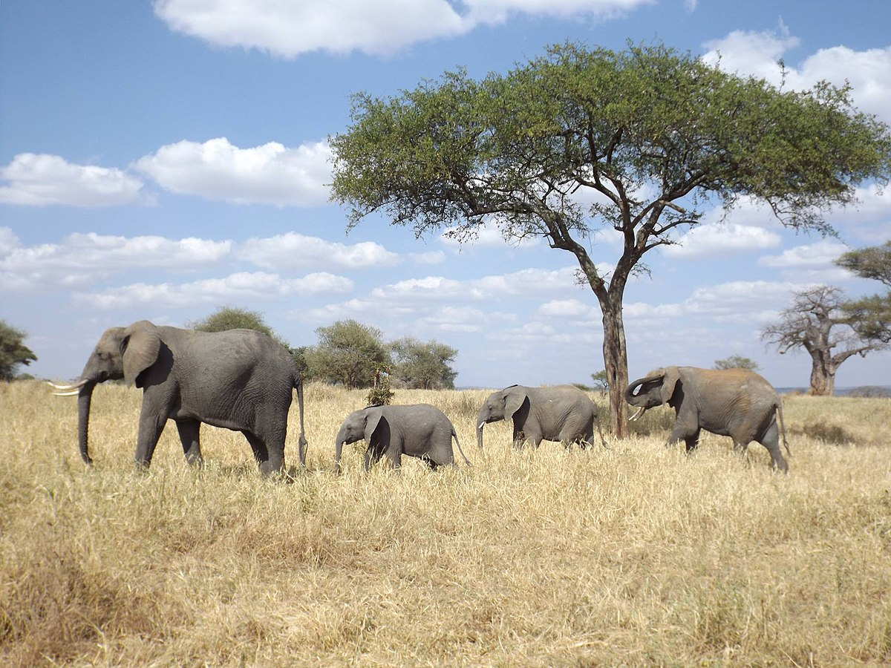
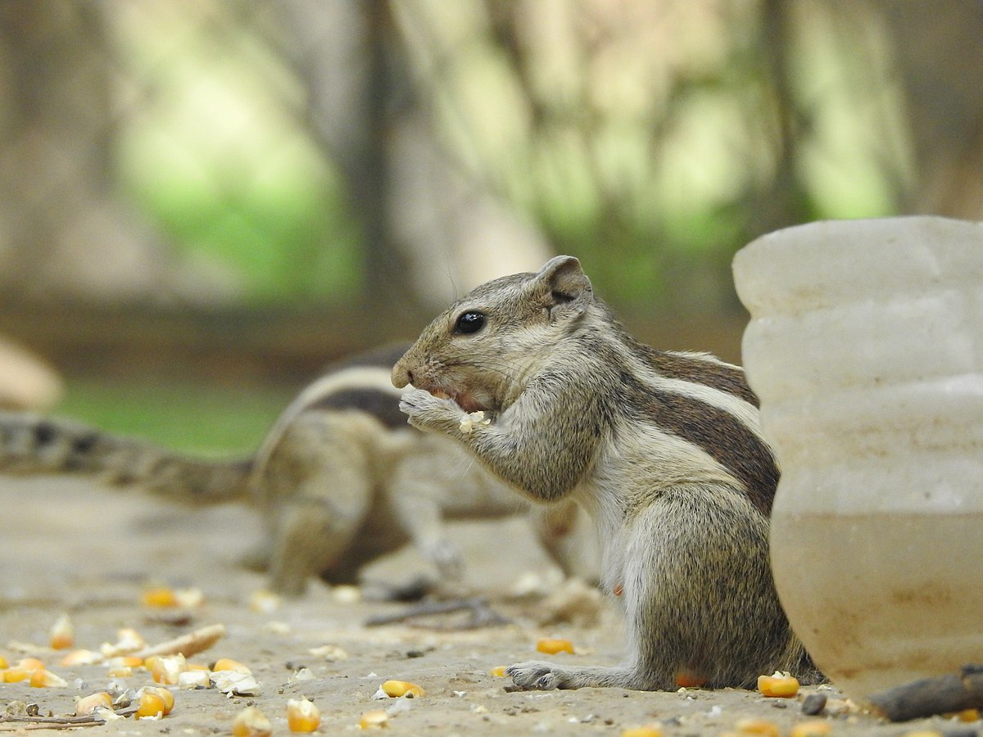
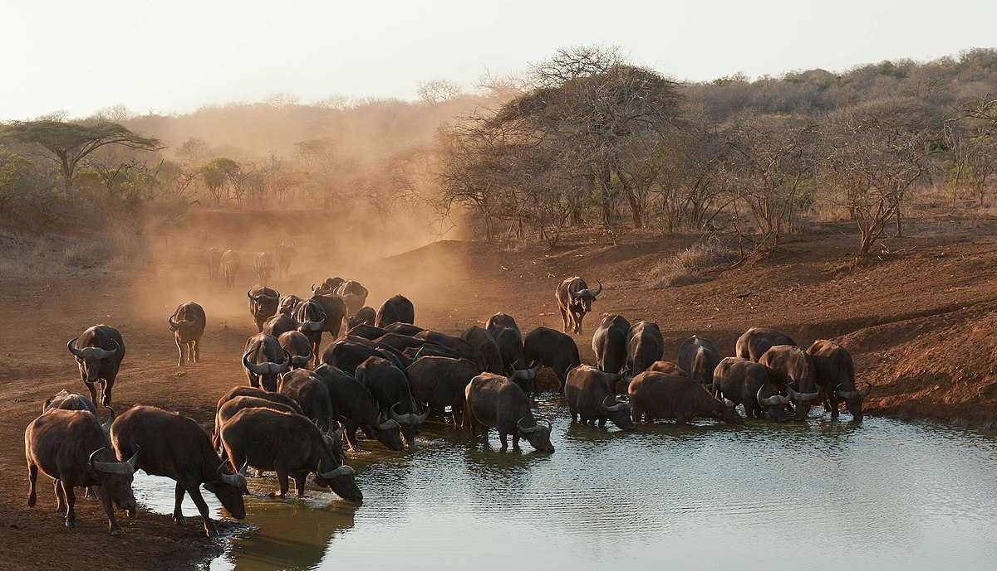
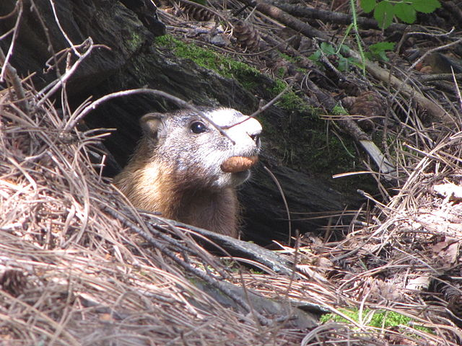
Why do animals move?
Mother elephant with offspring,
photo by Floodmfx, CC0, via Wikimedia Commons
Foraging chipmunk, photo by Prashant Saini,
CC BY-SA 4.0, via Wikimedia Commons
African buffalos drinking at a pond
photo by safaritravelplus, CC0, via Wikimedia Commons
Black hills marmot, photo by Njschock,
CC BY-SA 3.0, via Wikimedia Commons
Searching for food/nutrients
Searching for water
Searching for new den/nest
Searching for mate/group
Use spatial needs as a proxy for individual needs

Slide 3
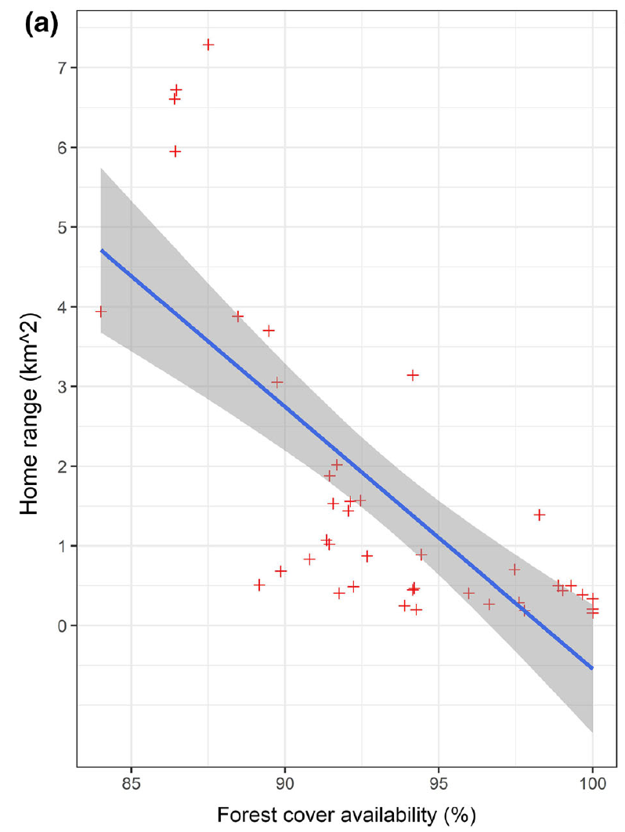
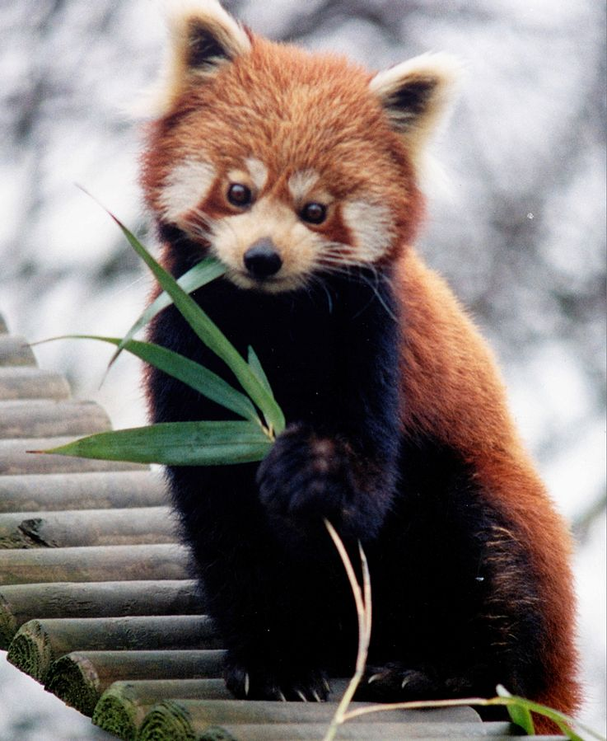
Resource abundance and HR: examples in literature
Red panda,
photo by Brunswyk, CC BY-SA 3.0,
via Wikimedia Commons
(Bista et al. 2022)

Slide 4
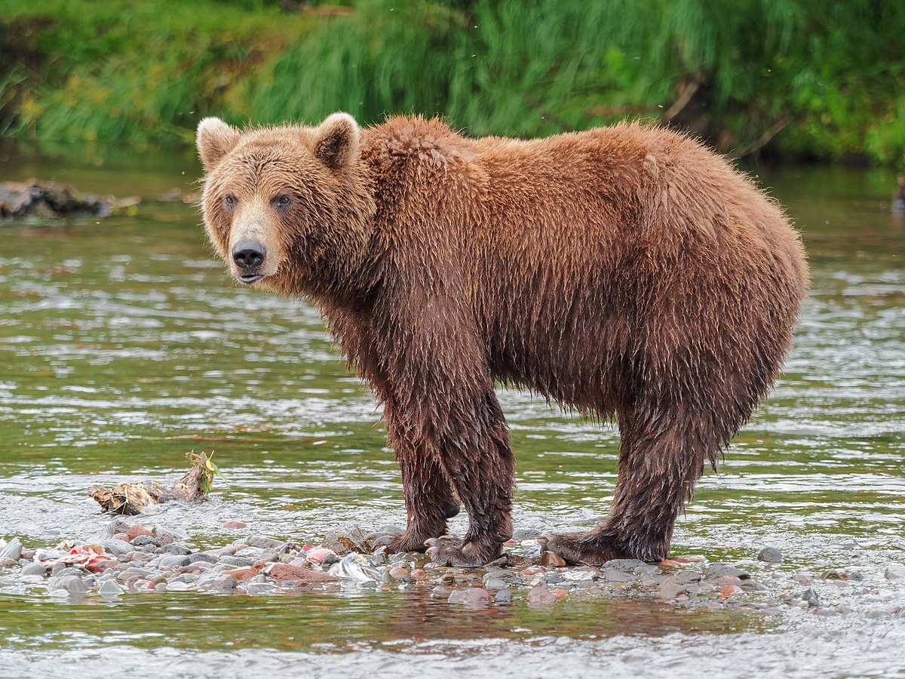
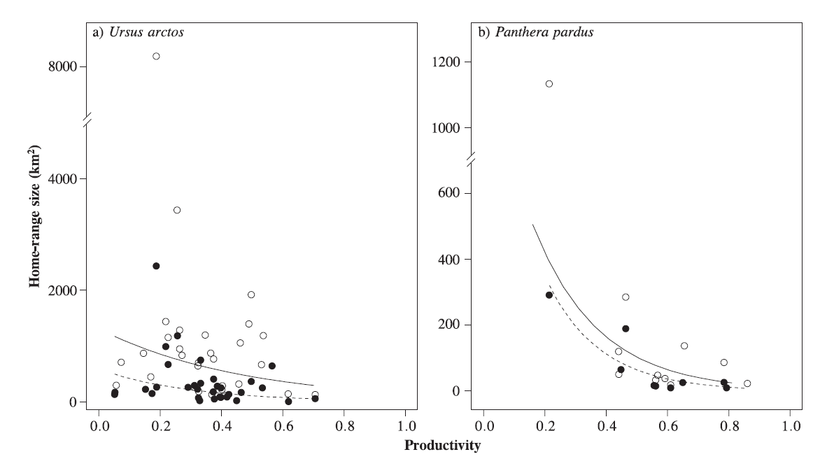
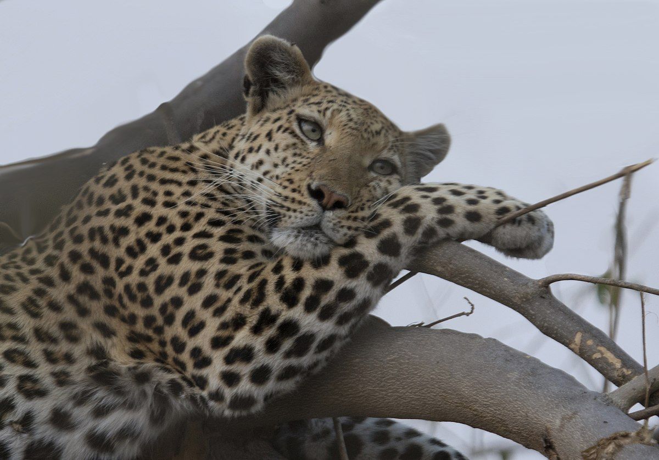
Resource abundance and HR: examples in literature
Brown bear, photo by Robert F. Tobler, CC BY-SA 4.0, via Wikimedia Commons
Leopard, photo by Gregory "Slobirdr" Smith, CC BY-SA 2.0, via Wikimedia Commons
(Nilsen et al. 2005)

Slide 5
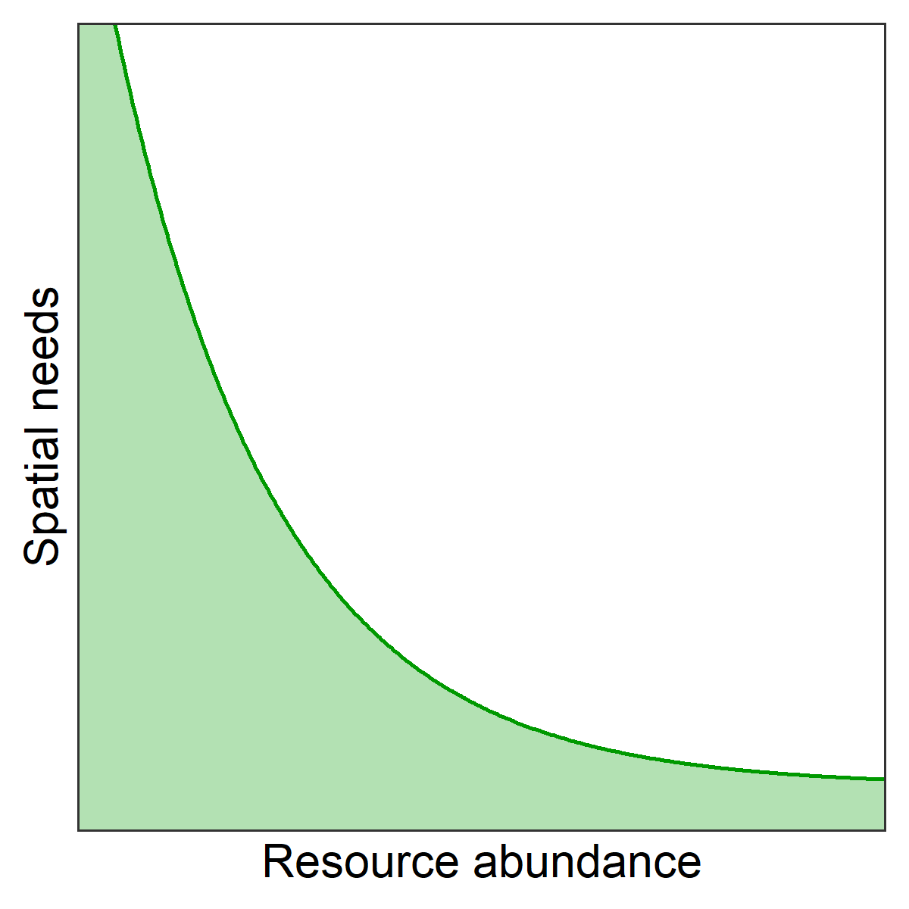
Resource abundance and HR: a unifying framework

Slide 6
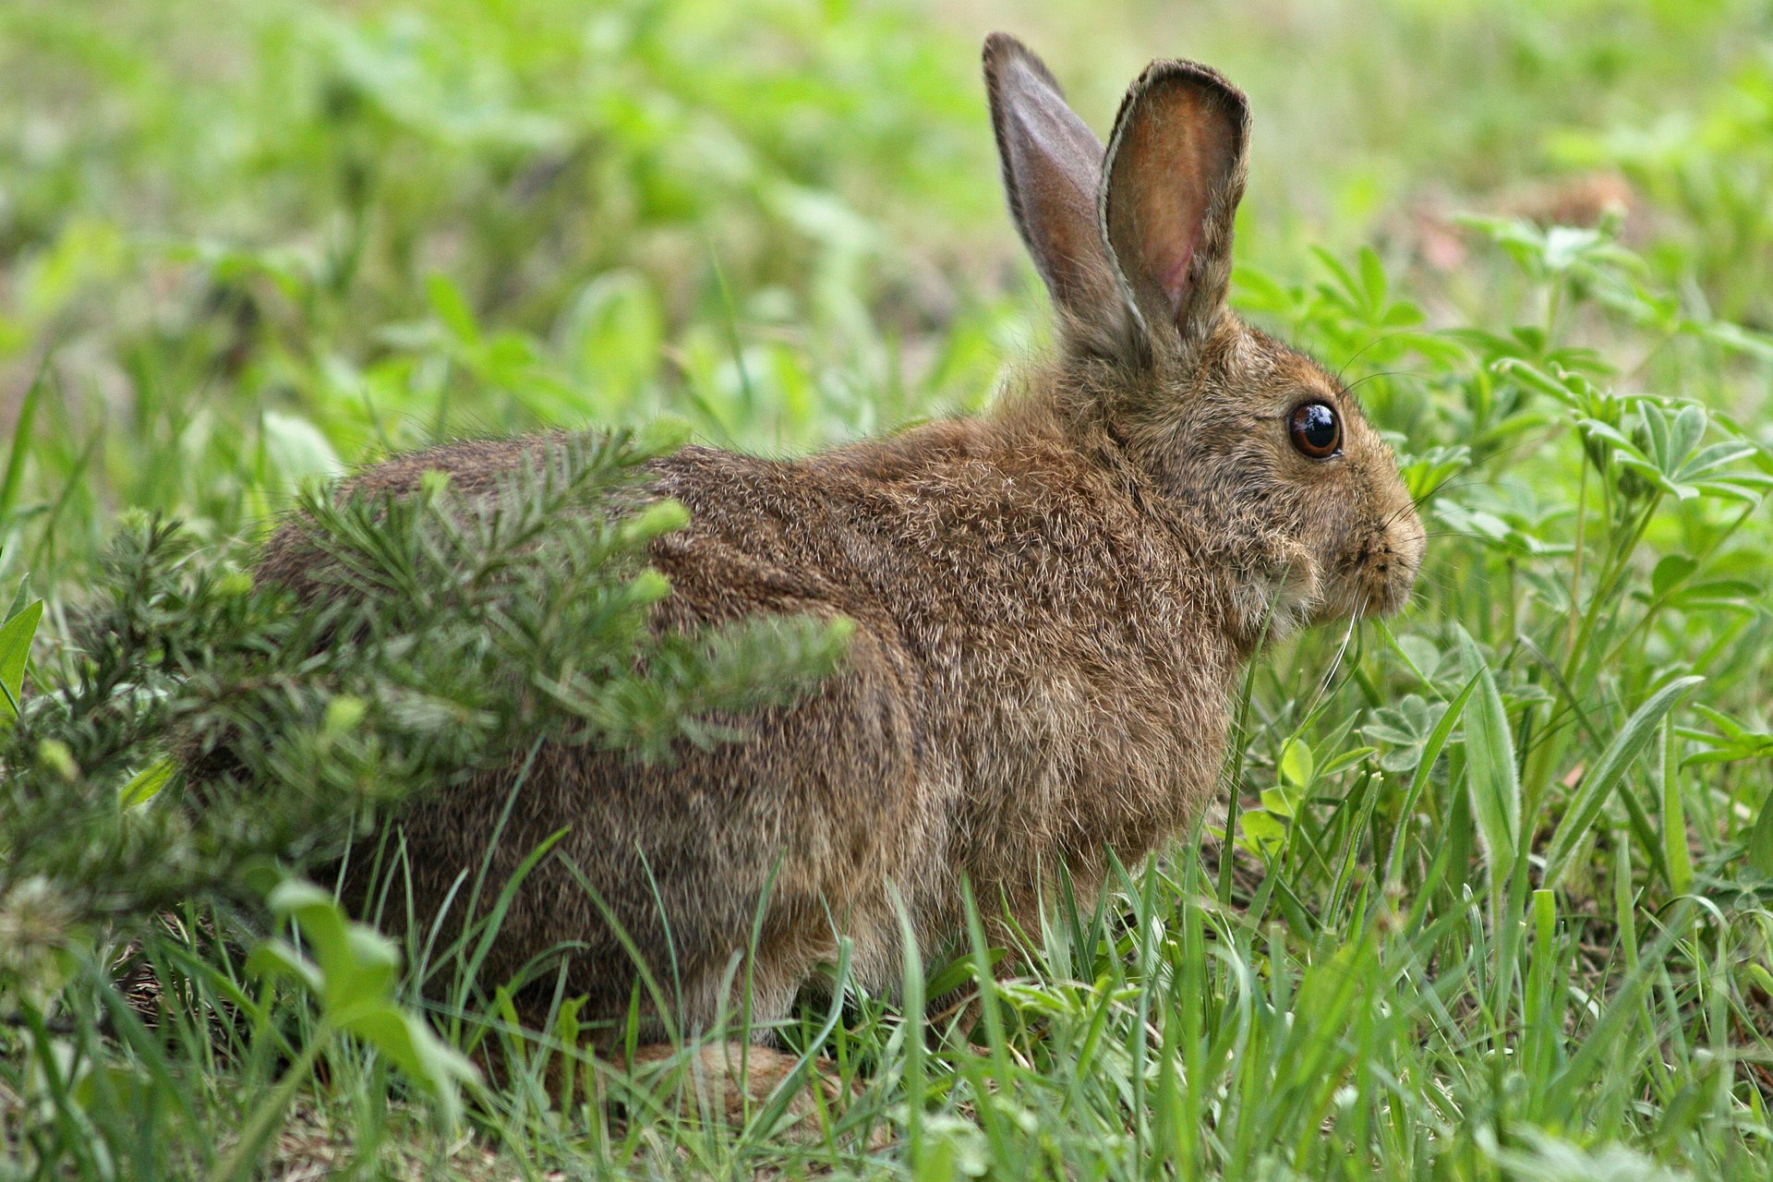
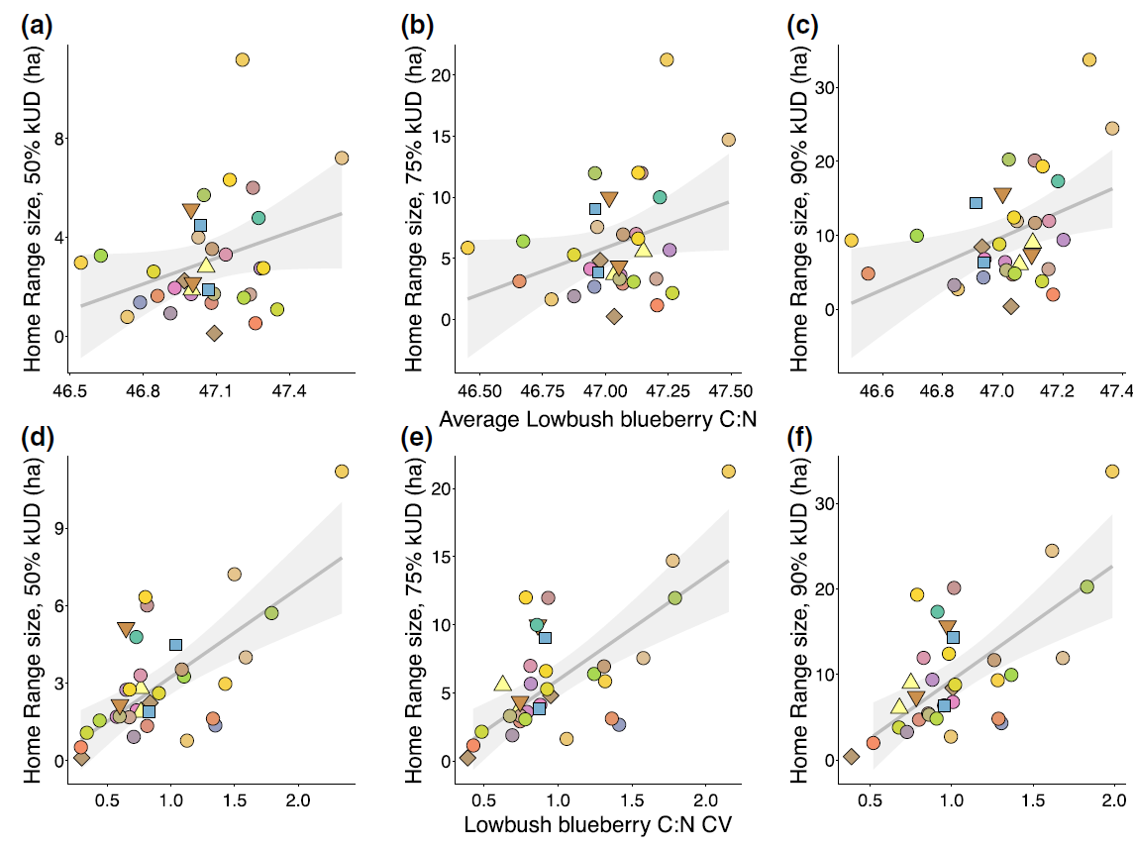
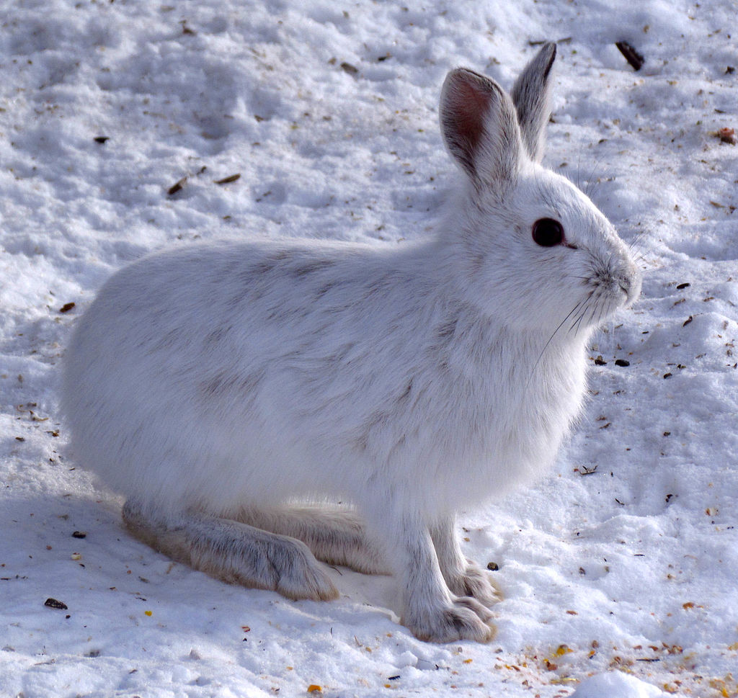
Resource unpredictability and HR: examples in literature
Showshoe hares, photos by
Walter Siegmund (top) and D. Gordon and E. Robertson (bottom), CC BY-SA 3.0, via Wikimedia Commons
(Rizzuto et al. 2021)

Slide 7
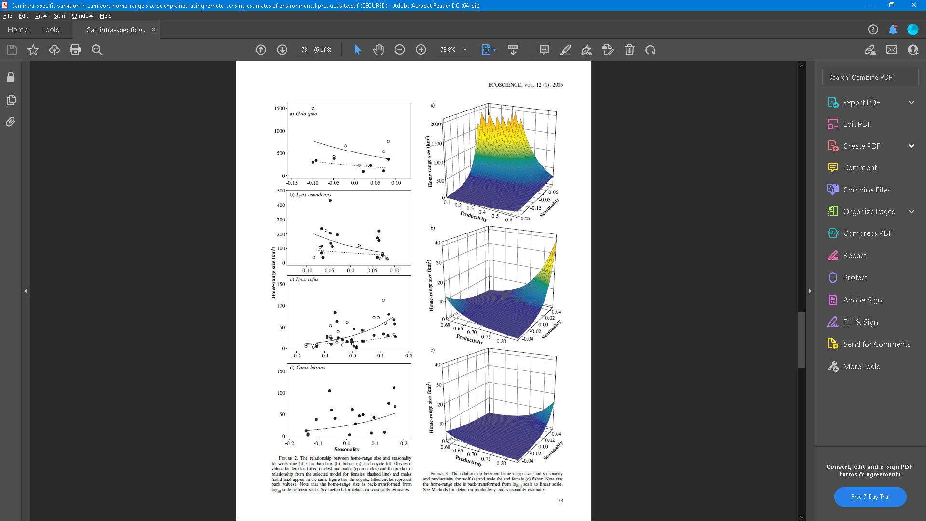
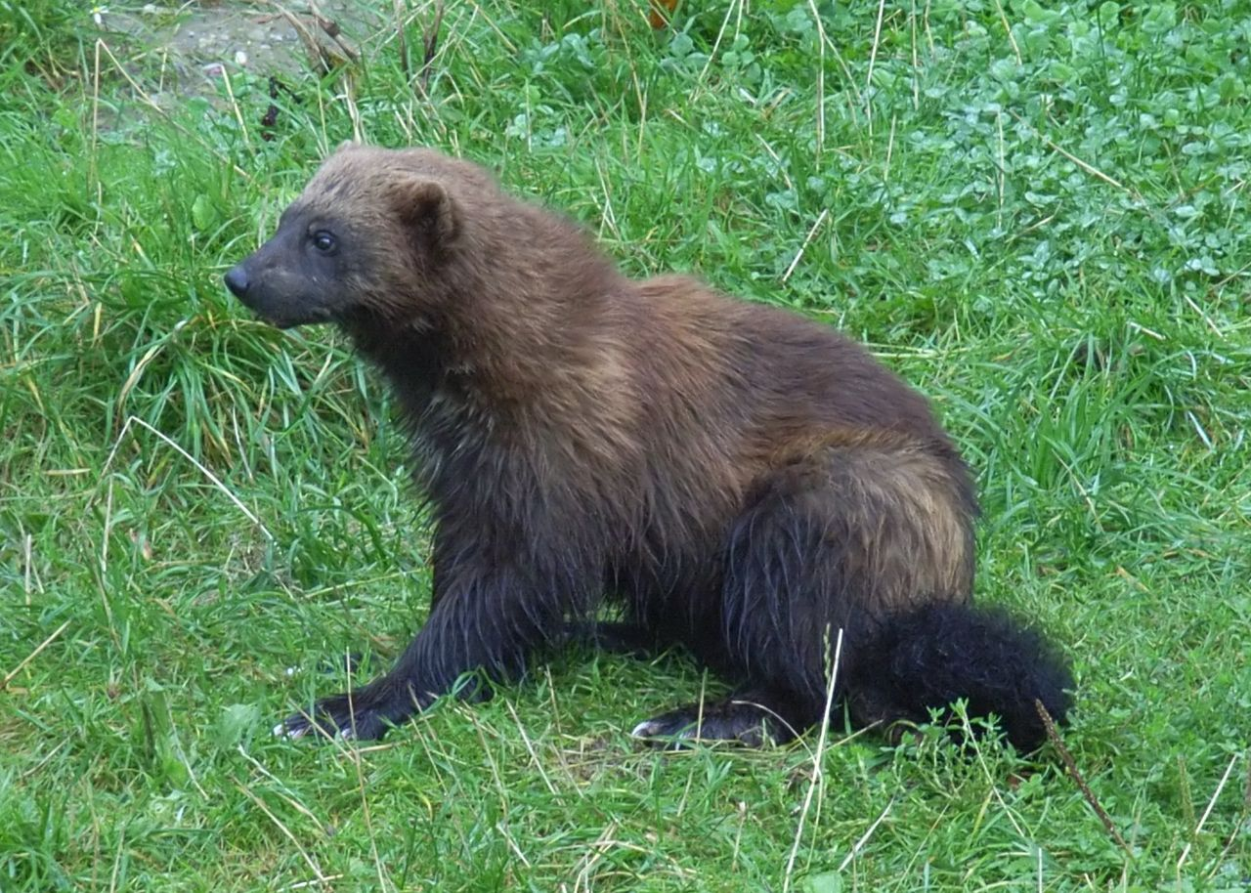
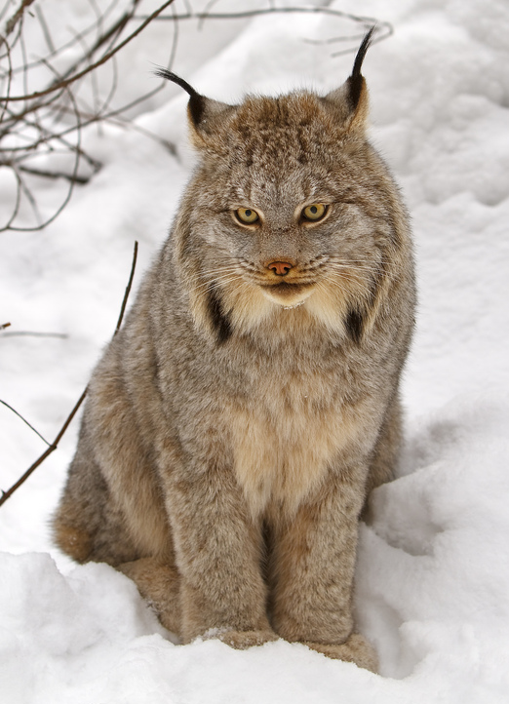
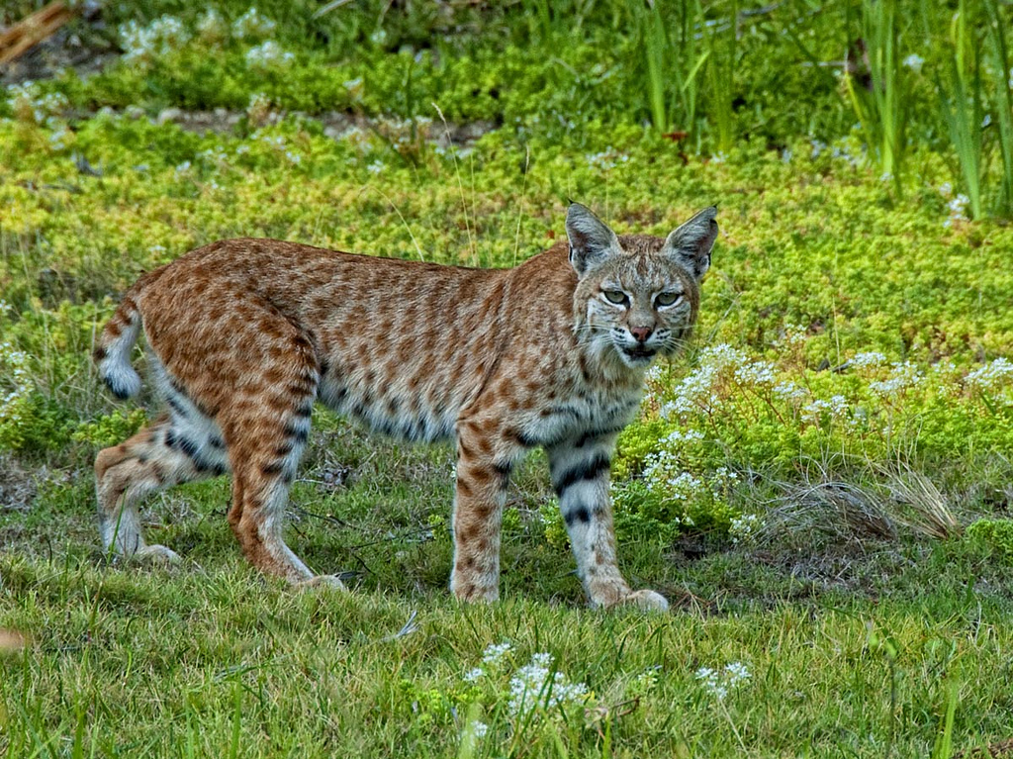
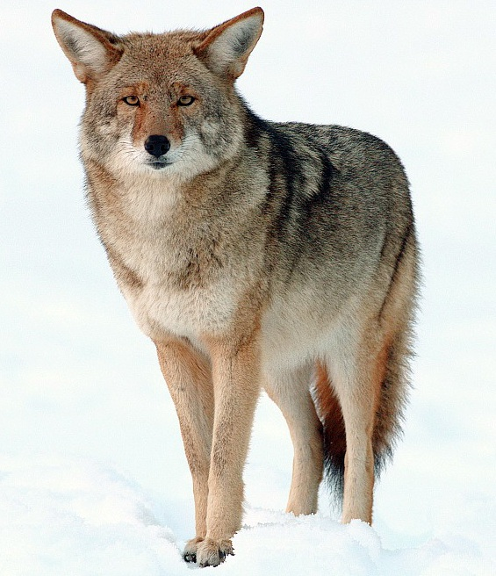
Resource unpredictability and HR: examples in literature
Canadian lynx,
photo by Michael Zahra,
CC BY-SA 3.0,
via Wikimedia Commons
Wolverine, Zefram, CC BY-SA 3.0, via Wikimedia Commons
Coyote,
photo by Yathin S Krishnappa, CC BY-SA 3.0, via Wikimedia Commons
Bobcat, photo by Bill W Ca, CC BY-SA 3.0, via Wikimedia Commons
(Nilsen et al. 2005)

Slide 8
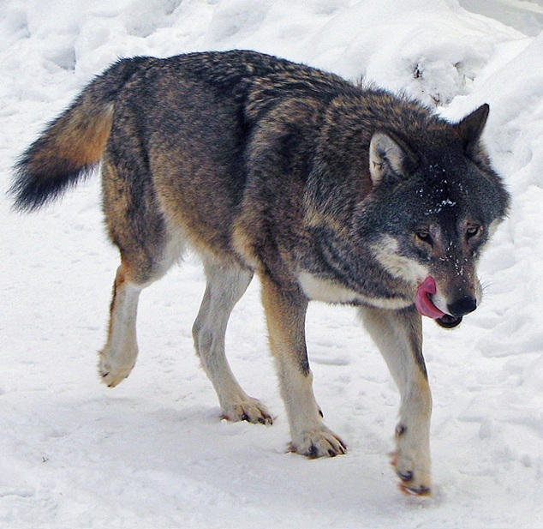
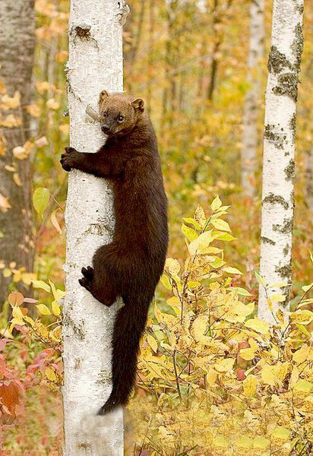
Resource unpredictability and HR: examples in literature
Fisher, photo by Douglas H. Domedion, CC BY-SA 4.0, via Wikimedia Commons
Wolf, photo by Daniel Mott,
CC BY-SA 2.0,
via Wikimedia Commons
(Nilsen et al. 2005)

Slide 9
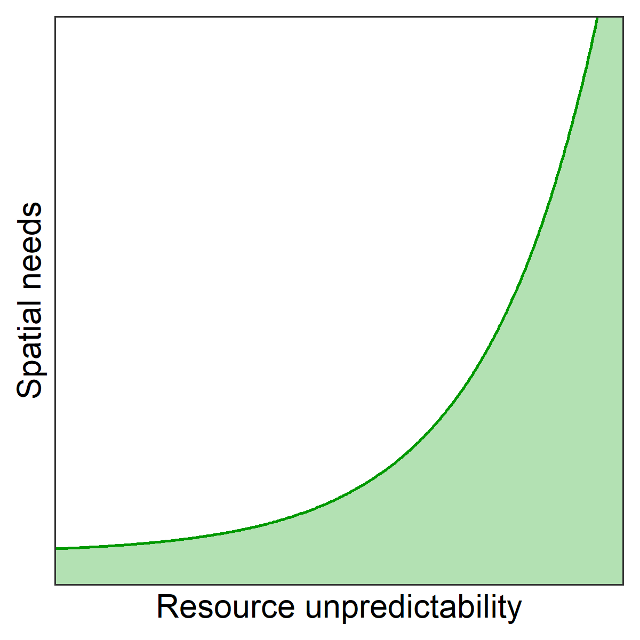
Resource unpredictability and HR: a unifying framework

Slide 10
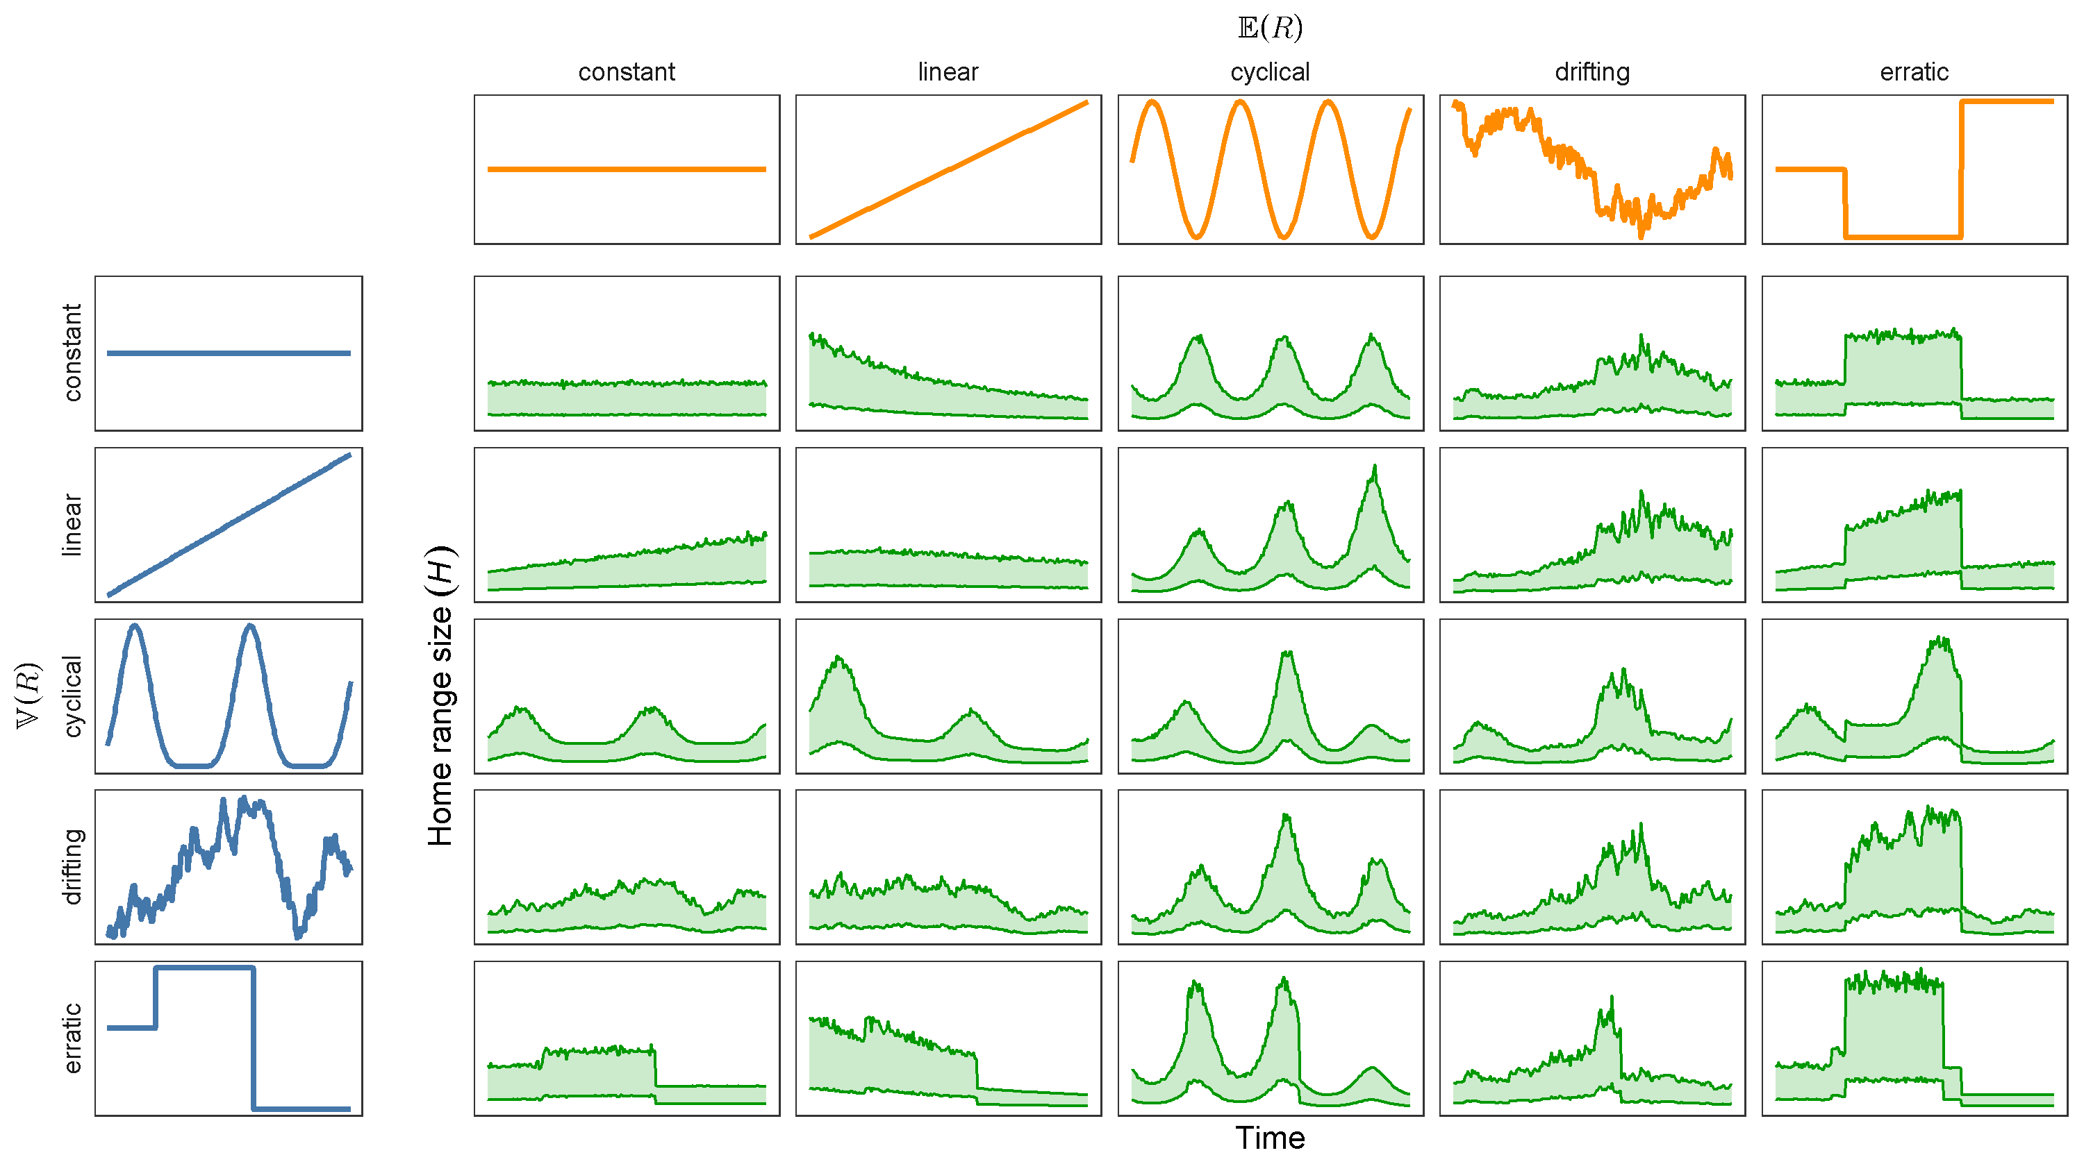
Relationships can be complicated…
Resource abundance
Resource unpredictability
Spatial needs

Slide 11
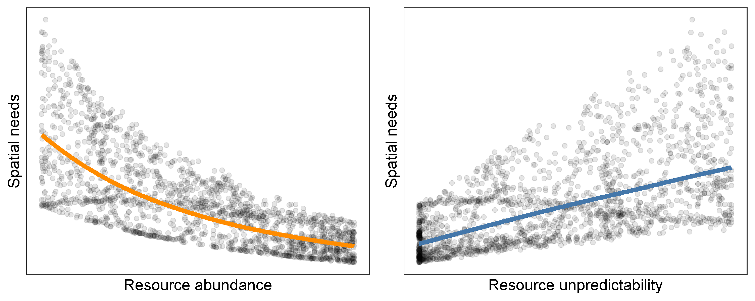
…but they can also be simple!

Slide 12
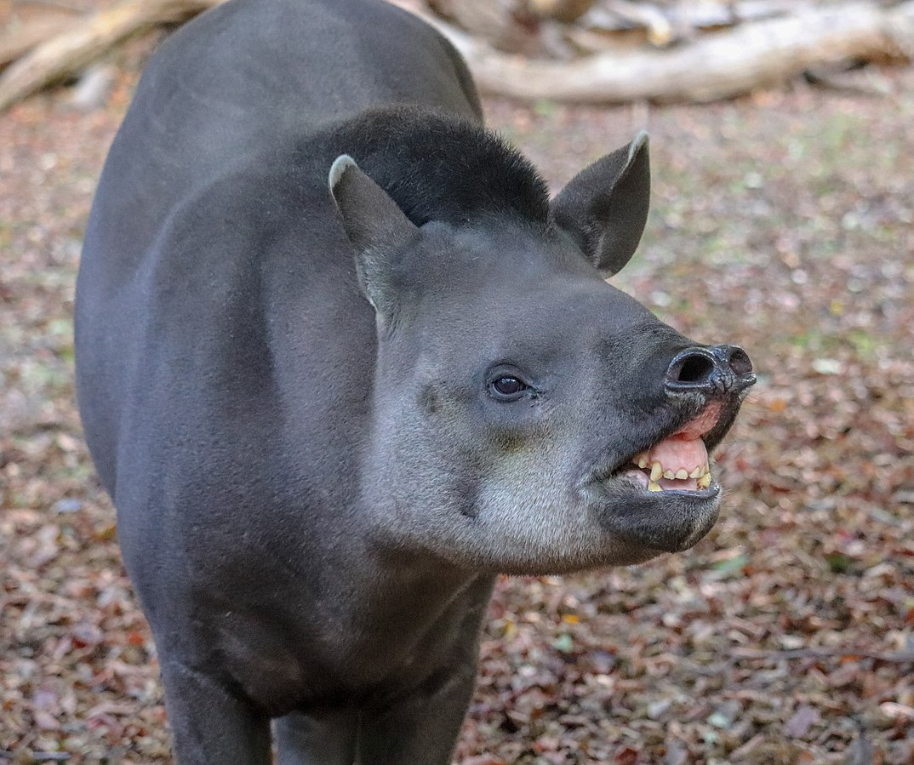
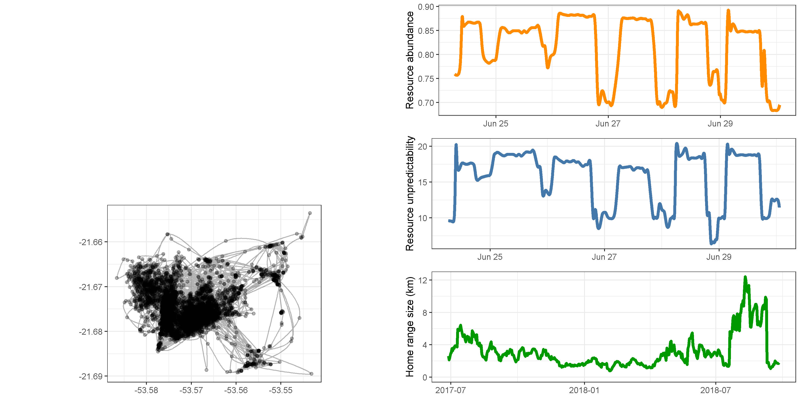
Complex relationships in “real data”
Tapir, Vauxford, CC BY-SA 4.0, via Wikimedia Commons

Slide 13
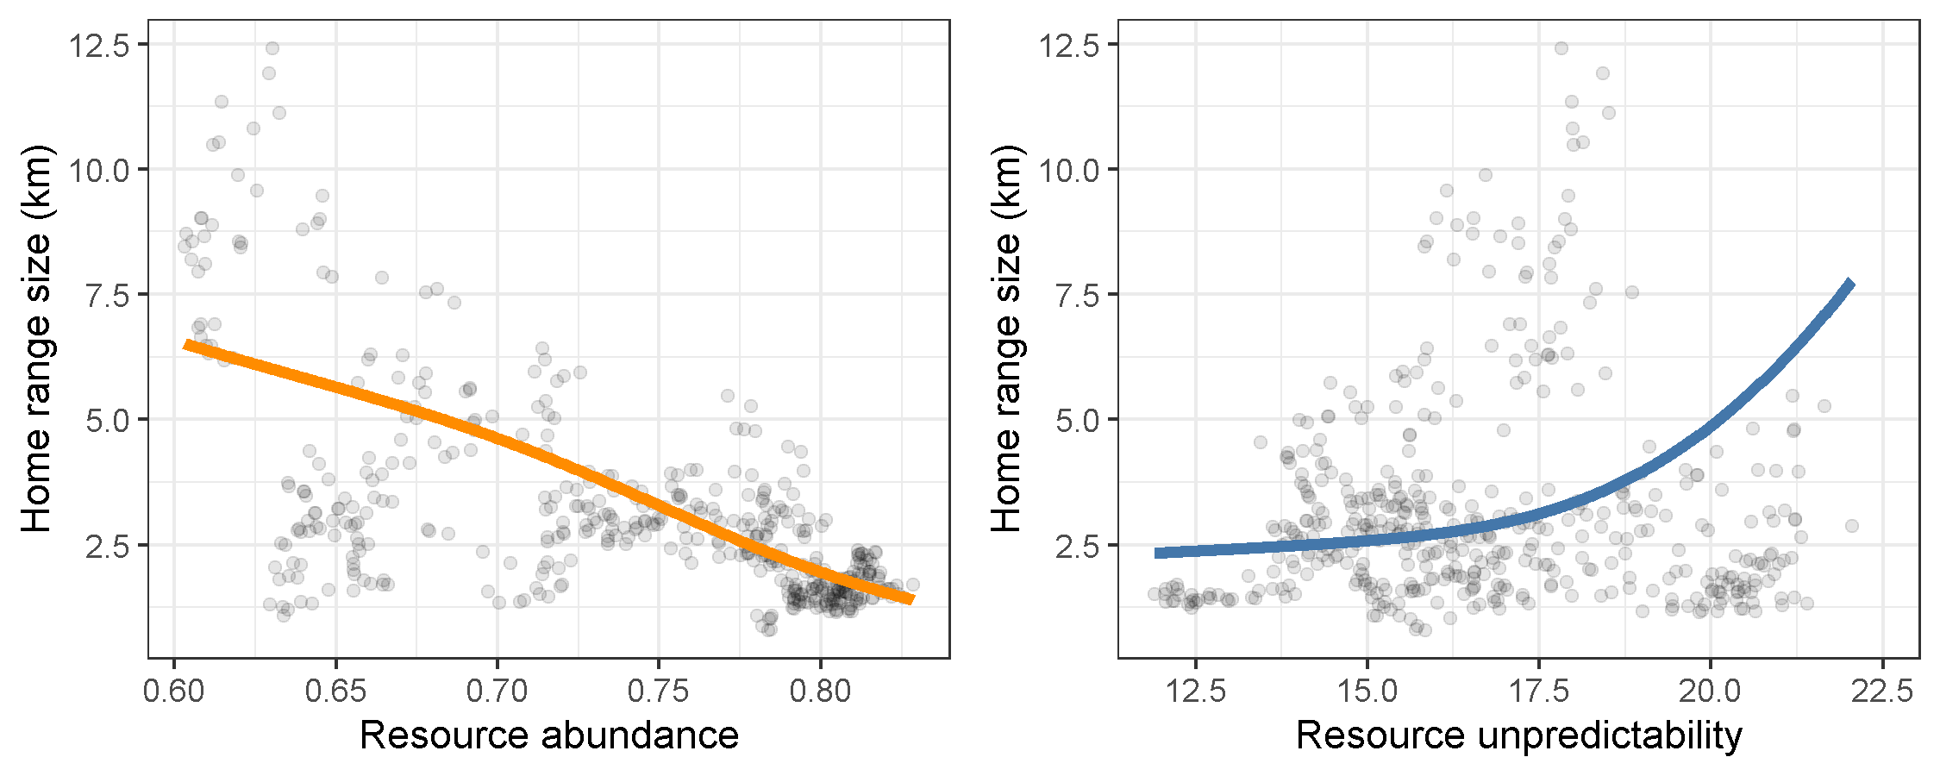
Simple relationships in “real data”!

Slide 14
Summary
Spatial needs:
Decrease nonlinearly with resource abundance
Increase linearly with resource unpredictability
May vary between species and populations
Use new unifying framework to:
Understand and generalize relationships
Make predictions!

Slide 15




Funder acknowledgements

Slide 16
Summary
Spatial needs:
Decrease nonlinearly with resource abundance
Increase linearly with resource unpredictability
May vary between species and populations
Use new unifying framework to:
Understand and generalize relationships
Make predictions!

Slide 17
References
Bista, D., G. S. Baxter, N. J. Hudson, S. T. Lama, and P. J. Murray. 2022. Effect of disturbances and habitat fragmentation on an arboreal habitat specialist mammal using GPS telemetry: A case of the red panda. Landscape Ecology 37:795–809. https://doi.org/10.1007/s10980-021-01357-w
Bengsen A.J., Algar D., Ballard G., Buckmaster T., Comer S., Fleming P.J.S., et al. (2016). Feral cat home-range size varies predictably with landscape productivity and population density. Journal of Zoology 298, 112–120. https://doi.org/10.1111/jzo.12290
Nilsen E.B., Herfindal I. & Linnell J.D.C. (2005). Can intra-specific variation in carnivore home-range size be explained using remote-sensing estimates of environmental productivity? Écoscience 12, 68–75. https://doi.org/10.2980/i1195-6860-12-1-68.1
Rizzuto M., Leroux S.J., Vander Wal E., Richmond I.C., Heckford T.R., Balluffi-Fry J., et al. (2021). Forage stoichiometry predicts the home range size of a small terrestrial herbivore. Oecologia 197, 327–338. https://doi.org/10.1007/s00442-021-04965-0

